Slide 1


Chapter 2
Quality of Service (QoS)

Slide 2
QoS Support in IP Networks
Need for QoS
Principles
IntServ
DiffServ

Slide 3
QoS Layers
User
Perceptual
(e.g., window size, security)
Subjective Quality Metrics
Application
Media Quality
(e.g., frame rate, adaptation rules)
Objective Quality Metrics
System
Traffic
(e.g., bit rate, loss,
delay, jitter)
Local Devices
Network
Processing
(e.g., CPU scheduling, memory, hard drive)

Slide 4
QoS Support in IP Networks
Need for QoS
Principles
IntServ
DiffServ

Slide 5
The Need for QoS
Assigning different levels of priority to different IP traffic flows and provides special treatment to higher-priority IP traffic flows.
For higher-priority IP traffic flows:
  Reduces packet loss during times of network congestion
  Helps control delay (latency) and delay variation (jitter)
For low-priority IP traffic flows:
  Provides a best-effort delivery service.
  Used mechanisms:
  Classification and marking, policing and shaping, congestion management and avoidance.

Slide 6
Causes and Results of Quality Issues
When packets are delivered using a best-effort delivery model, they may not arrive in order or in a timely manner, and they may be dropped.
  For video, this can result in pixelization of the image, pausing, choppy video, audio and video being out of sync, or no video at all.
  For audio, it could cause echo, talker overlap (a walkie-talkie effect where only one person can speak at a time), unintelligible and distorted speech, voice breakups, long silence gaps, and call drops.
The following are the leading causes of quality issues:
  Lack of bandwidth
  Latency and jitter
  Packet loss

Slide 7
Lack of Bandwidth
The available bandwidth on the data path from a source to a destination equals the capacity of the lowest-bandwidth link.
When the maximum capacity of the lowest-bandwidth link is surpassed, link congestion takes place, resulting in traffic drops.
The solution to this type of problem:
Increase the link bandwidth capacity
Implement QoS mechanisms such as policing and queueing to prioritize traffic according to level of importance.
  Voice, video, and business-critical traffic should get prioritized forwarding and sufficient bandwidth to support their application requirements.
  The least important traffic should be allocated the remaining bandwidth.

Slide 8
Latency and Jitter
One-way end-to-end delay, also known as network latency, is the time it takes for packets to travel across a network from a source to a destination.
Regardless of the application type, ITU Recommendation G.114 recommends:
  A network latency of 400 ms should not be exceeded,
  For real-time traffic, network latency should be less than 150 ms;
  ITU demonstrated that real-time traffic quality does not begin to significantly degrade until network latency exceeds 200 ms.
Network latency can be broken down into fixed and variable latency:
  Propagation delay (fixed)
  Serialization delay (fixed)
  Processing delay (fixed)
  Delay variation (variable)

Slide 9
Serialization Delay/Processing Delay
Serialization delay is the time it takes to place all the bits of a packet onto a link.
  It is a fixed value that depends on the link speed; the higher the link speed, the lower the delay.
  The serialization delay s is equal to the packet size in bits divided by the line speed in bits per second.
Processing delay is the fixed amount of time it takes for a networking device to take the packet from an input interface and place the packet onto the output queue of the output interface.
  The processing delay depends on factors such as the following:
  CPU speed (for software-based platforms)
  Router architecture (centralized or distributed)
  Configured features on both input and output interfaces

Slide 10
Delay Variation/Packet Loss
Delay variation / jitter is the difference in the latency between packets in a single flow.
Experienced due to the queueing delay experienced during periods of network congestion.
Packet loss is usually a result of congestion on an interface, and can be prevented by implementing one of the following approaches:
  Increase link speed.
  Implement QoS congestion-avoidance and congestion-management mechanism.
  Implement traffic policing to drop low-priority packets and allow high-priority traffic through.
  Implement traffic shaping to delay packets instead of dropping them since traffic may burst and exceed the capacity of an interface buffer.
      Traffic shaping is not recommended for real-time traffic because it relies on queuing that can cause jitter.

Slide 11
QoS Support in IP Networks
Need for QoS
Principles
IntServ
DiffServ

Slide 12
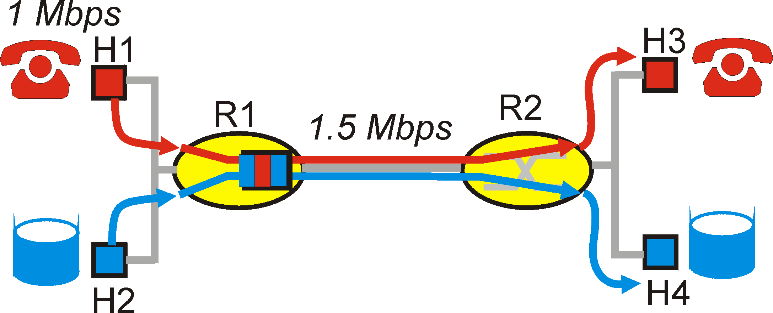
Principles for QoS Guarantees
Let us explore these functions using a simple example
  1Mbps IP phone, FTP share 1.5 Mbps link.
  bursts of FTP can congest router, cause audio loss
  want to give priority to audio over FTP
Principle 1
packet marking needed for router to distinguish between different classes; and new router policy to treat packets accordingly

Slide 13
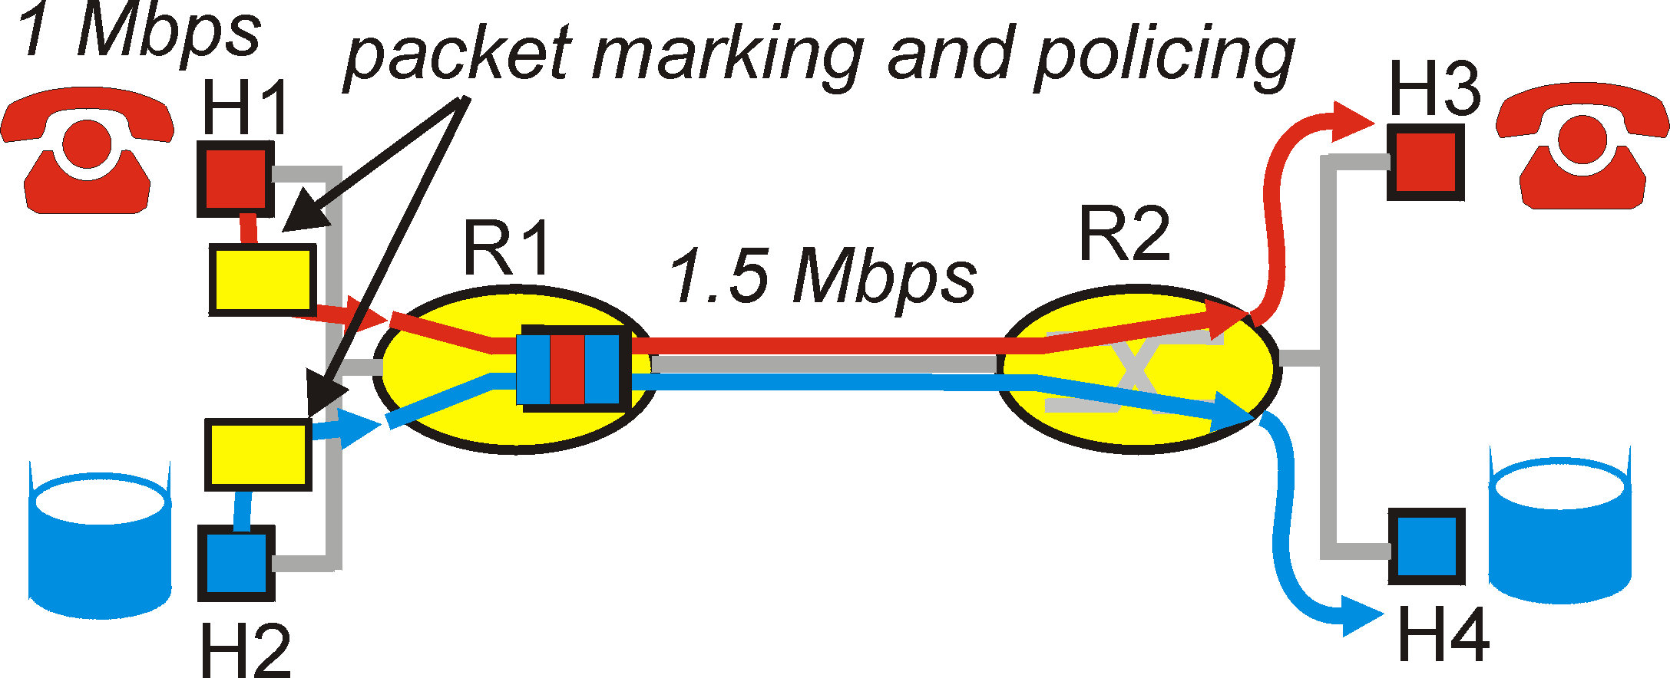
Principles for QoS Guarantees (more)
what if applications misbehave (audio sends higher than declared rate)
  policing: force source adherence to bandwidth allocations
marking and policing at network edge:
Principle 2
provide protection (isolation) for one class from others

Slide 14
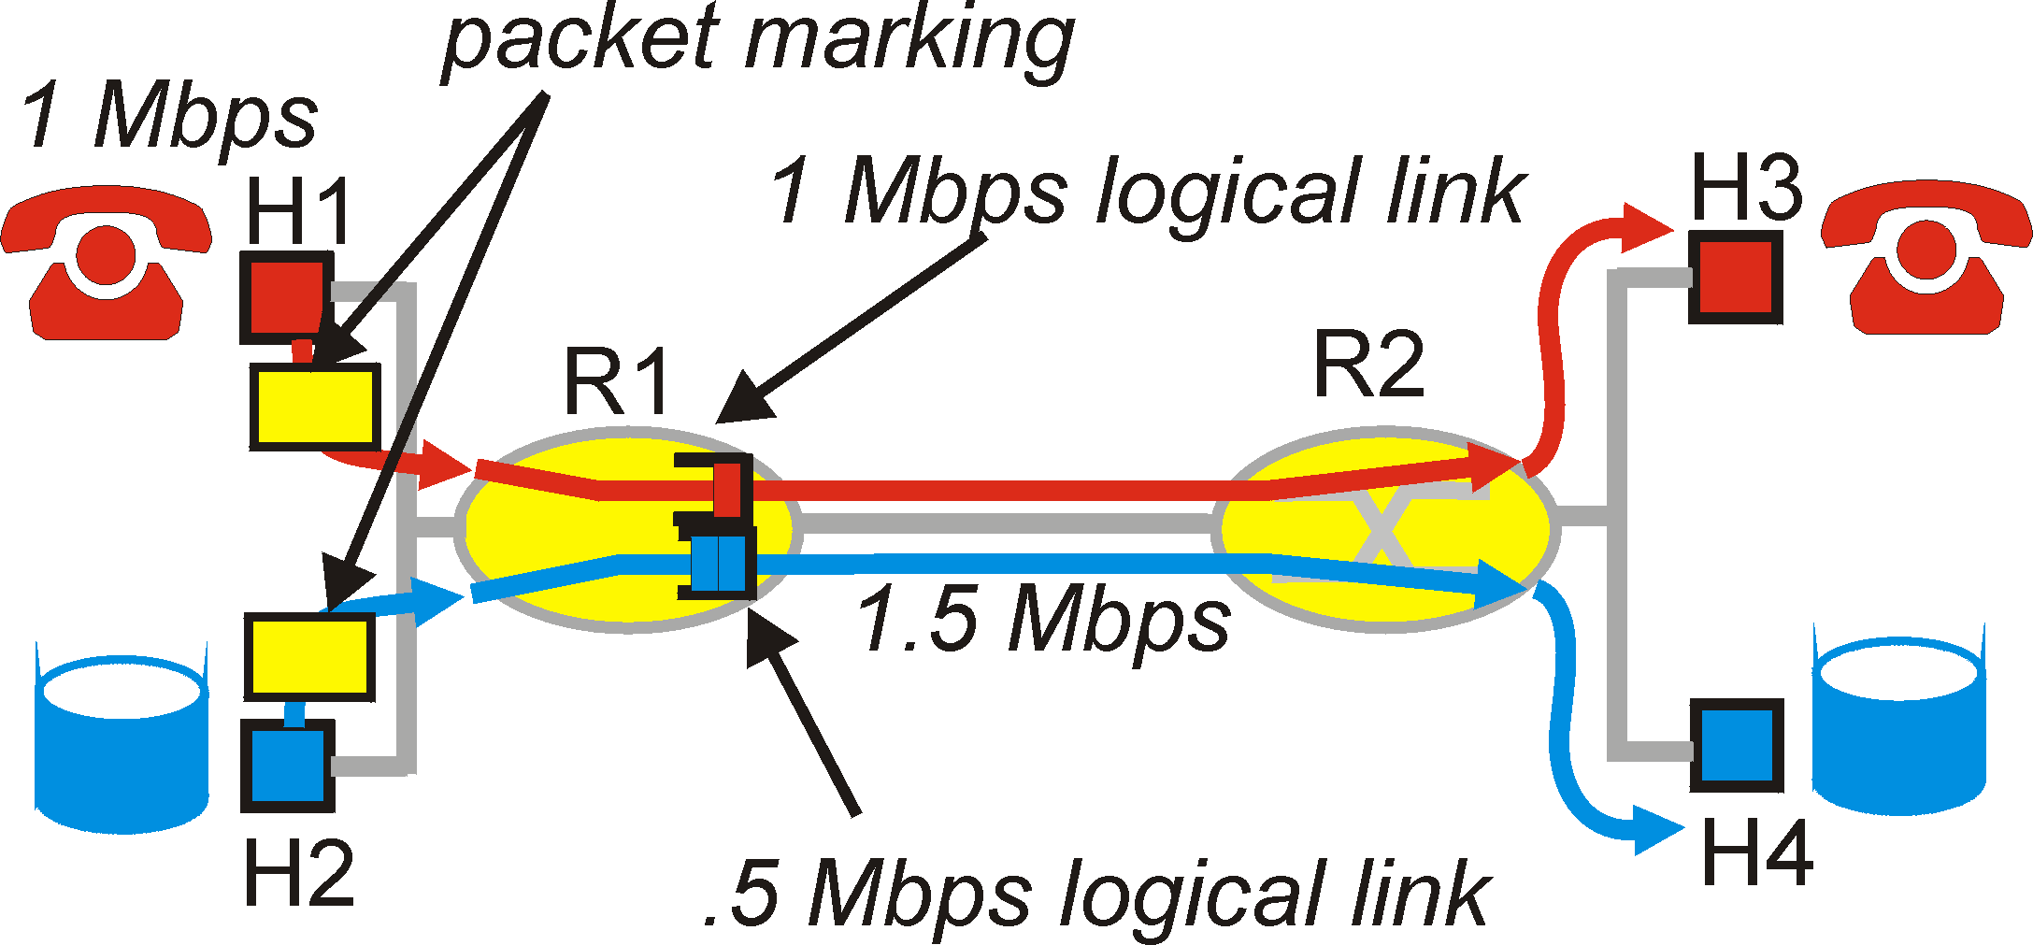
Principles for QoS Guarantees (more)
Allocating fixed (non-sharable) bandwidth to flow: inefficient use of bandwidth if flows doesn’t use its allocation
Principle 3
While providing isolation, it is desirable to use resources as efficiently as possible

Slide 15
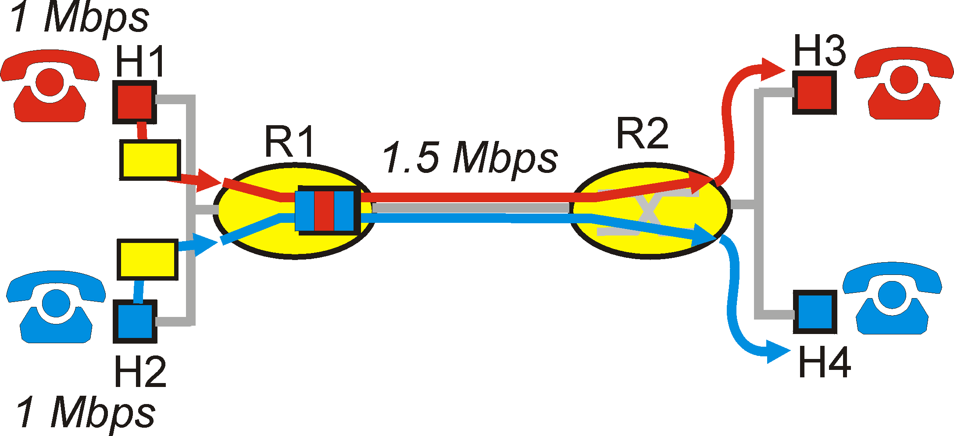
Principles for QoS Guarantees (more)
Basic fact of life: can not support traffic demands beyond link capacity
Principle 4
Call Admission: flow declares its needs, network may block call (e.g., busy signal) if it cannot meet needs

Slide 16
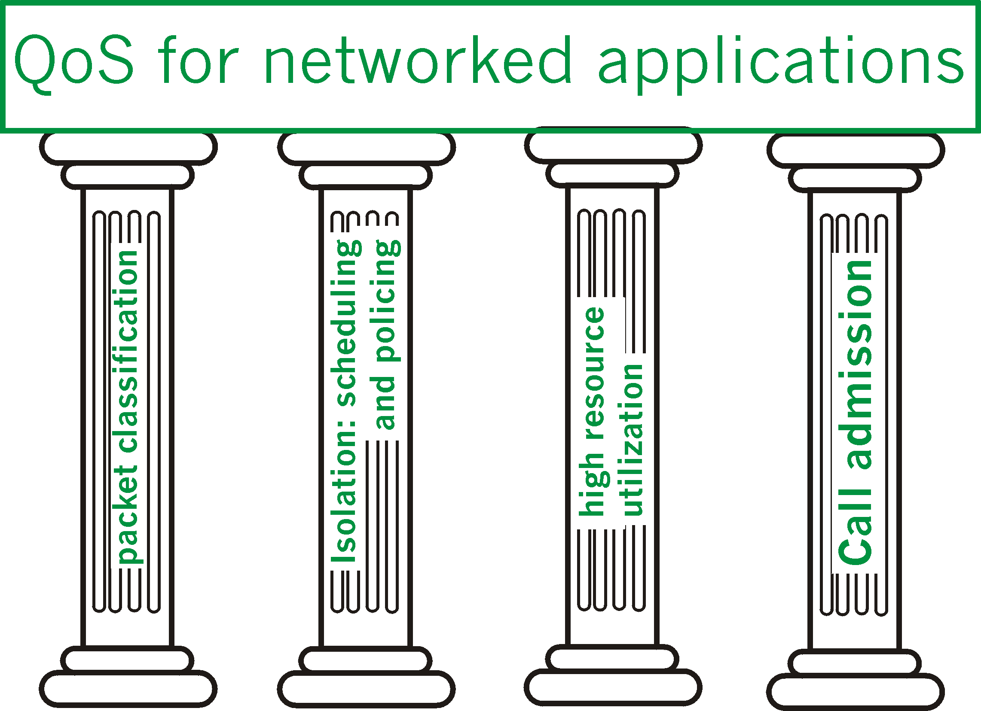
Summary of QoS Principles

Slide 17
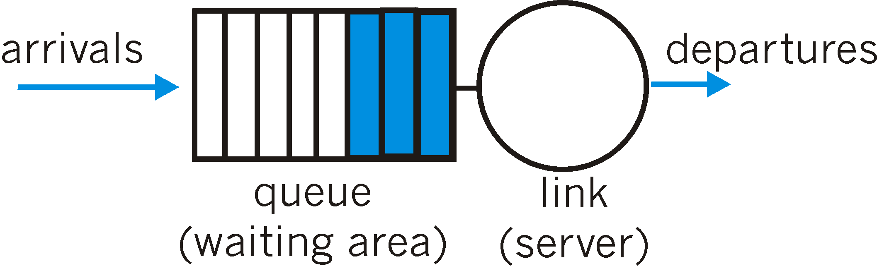
Scheduling And Policing Mechanisms
Scheduling: choose next packet to send on link
FIFO (first in first out) scheduling: send in order of arrival to queue
  Discard policy: if packet arrives to full queue: who to discard?
    Tail drop: drop arriving packet
    Priority: drop/remove on priority basis
    Random: drop/remove randomly

Slide 18
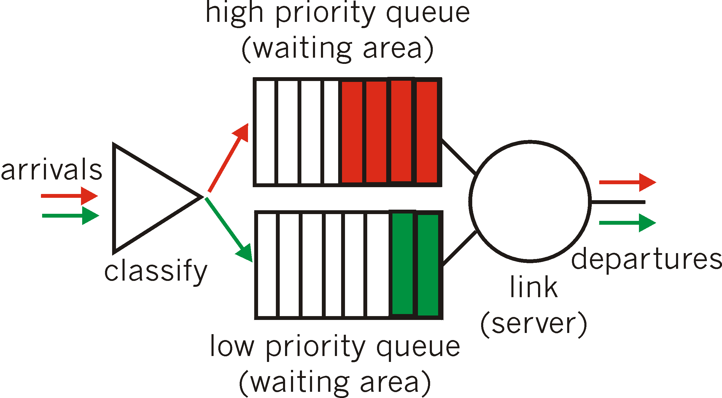
Scheduling Policies
Priority scheduling: transmit highest-priority queued packet
Multiple classes, with different priorities
  Class may depend on marking or other header info, e.g. IP source/dest, port numbers, etc..

Slide 19

Scheduling Policies
Weighted Fair Queuing:
Generalized Round Robin
Each class gets weighted amount of service in each cycle

Slide 20
Policing Mechanisms
Goal: limit traffic to not exceed declared parameters
Three common-used criteria:
(Long term) Average Rate: how many pkts can be sent per unit time
  Crucial question: what is the interval length: 100 packets per sec and 6000 packets per min (ppm) have same average!
Peak Rate: e.g.,
  Avg rate: 6000 ppm
  Peak rate: 25 pps (= 1500 ppm)
(Max.) Burst Size: max. number of pkts sent consecutively (with no intervening idle)
Putting it all together
Average Rate = long-term traffic load (e.g., 6000 ppm).
Peak Rate = maximum instantaneous sending speed (e.g., 25 pps).
Burst Size = how many packets can be sent consecutively before you must slow down.

Slide 21
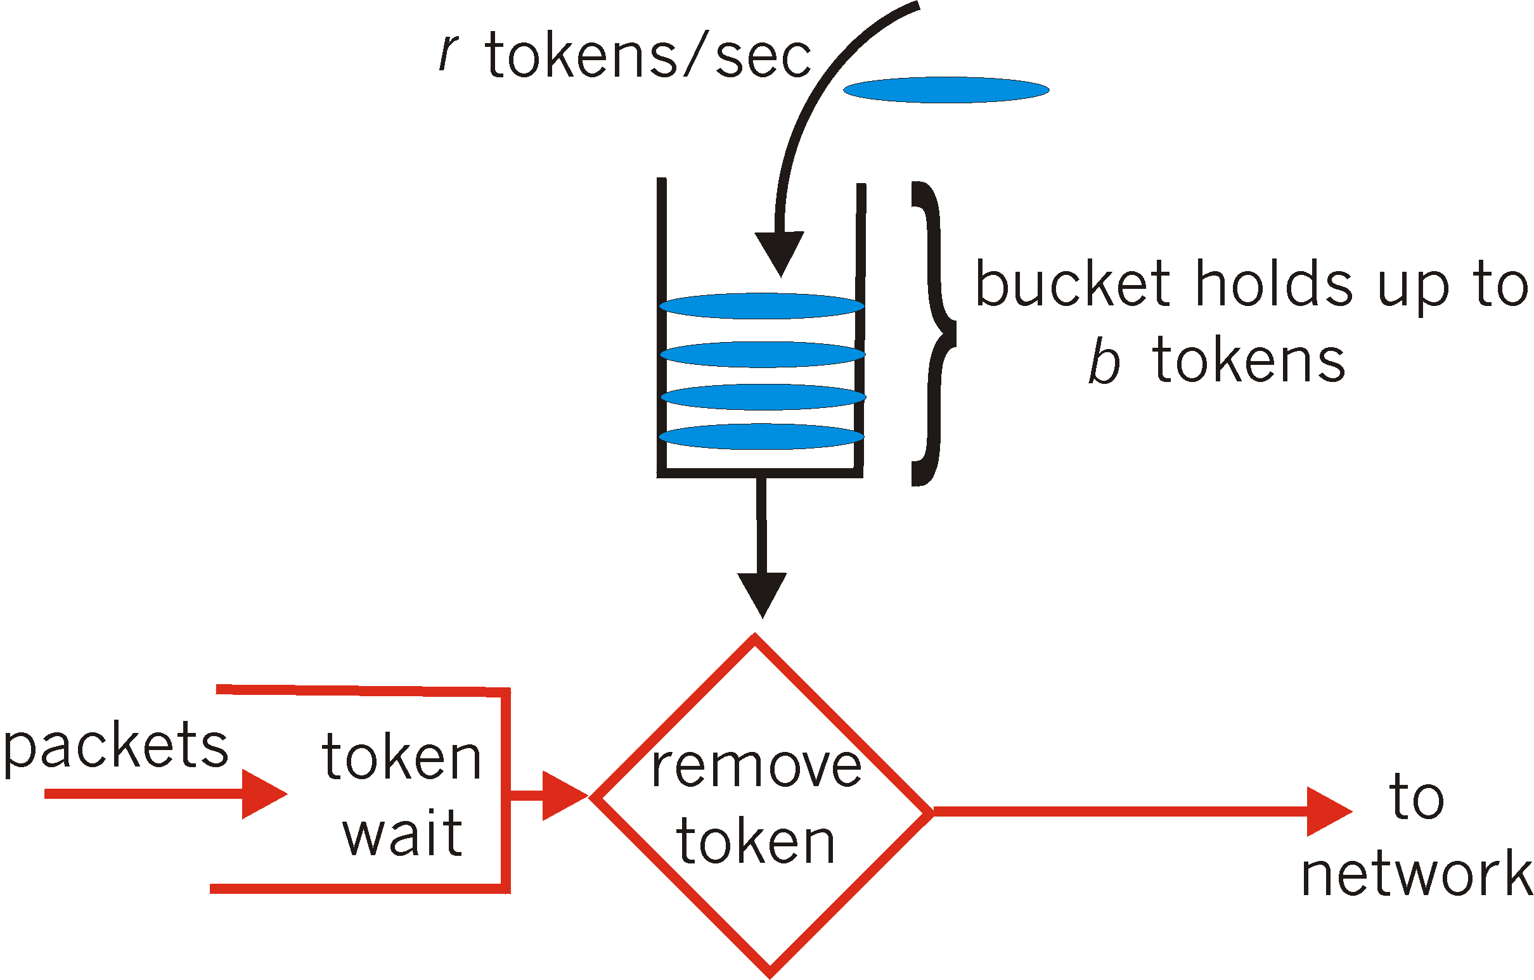
Policing Mechanisms
Leaky Bucket:
traffic shaping / policing mechanism
limit input to specified Burst Size and Average Rate.
Bucket can hold b tokens (Represents the burst size)
Tokens generated at rate r token/sec unless bucket full (represents the average rate)
Over interval of length t: number of packets admitted less than or equal to (r t + b).
!
If no tokens are available, the packet must wait (shaping) or is dropped (policing).

Slide 22
Policing Mechanisms
Leaky Bucket / Example:
Suppose:
Bucket size b=10 tokens.
Token generation rate r=5 tokens/sec.
Then:
At time t=0, bucket is full → 10 packets can be sent immediately (burst).
After that, only 5 packets per second can be sent (because only 5 new tokens arrive each second).
In any interval of t seconds, you can’t send more than:
r⋅t + b = 5t + 10

Slide 23
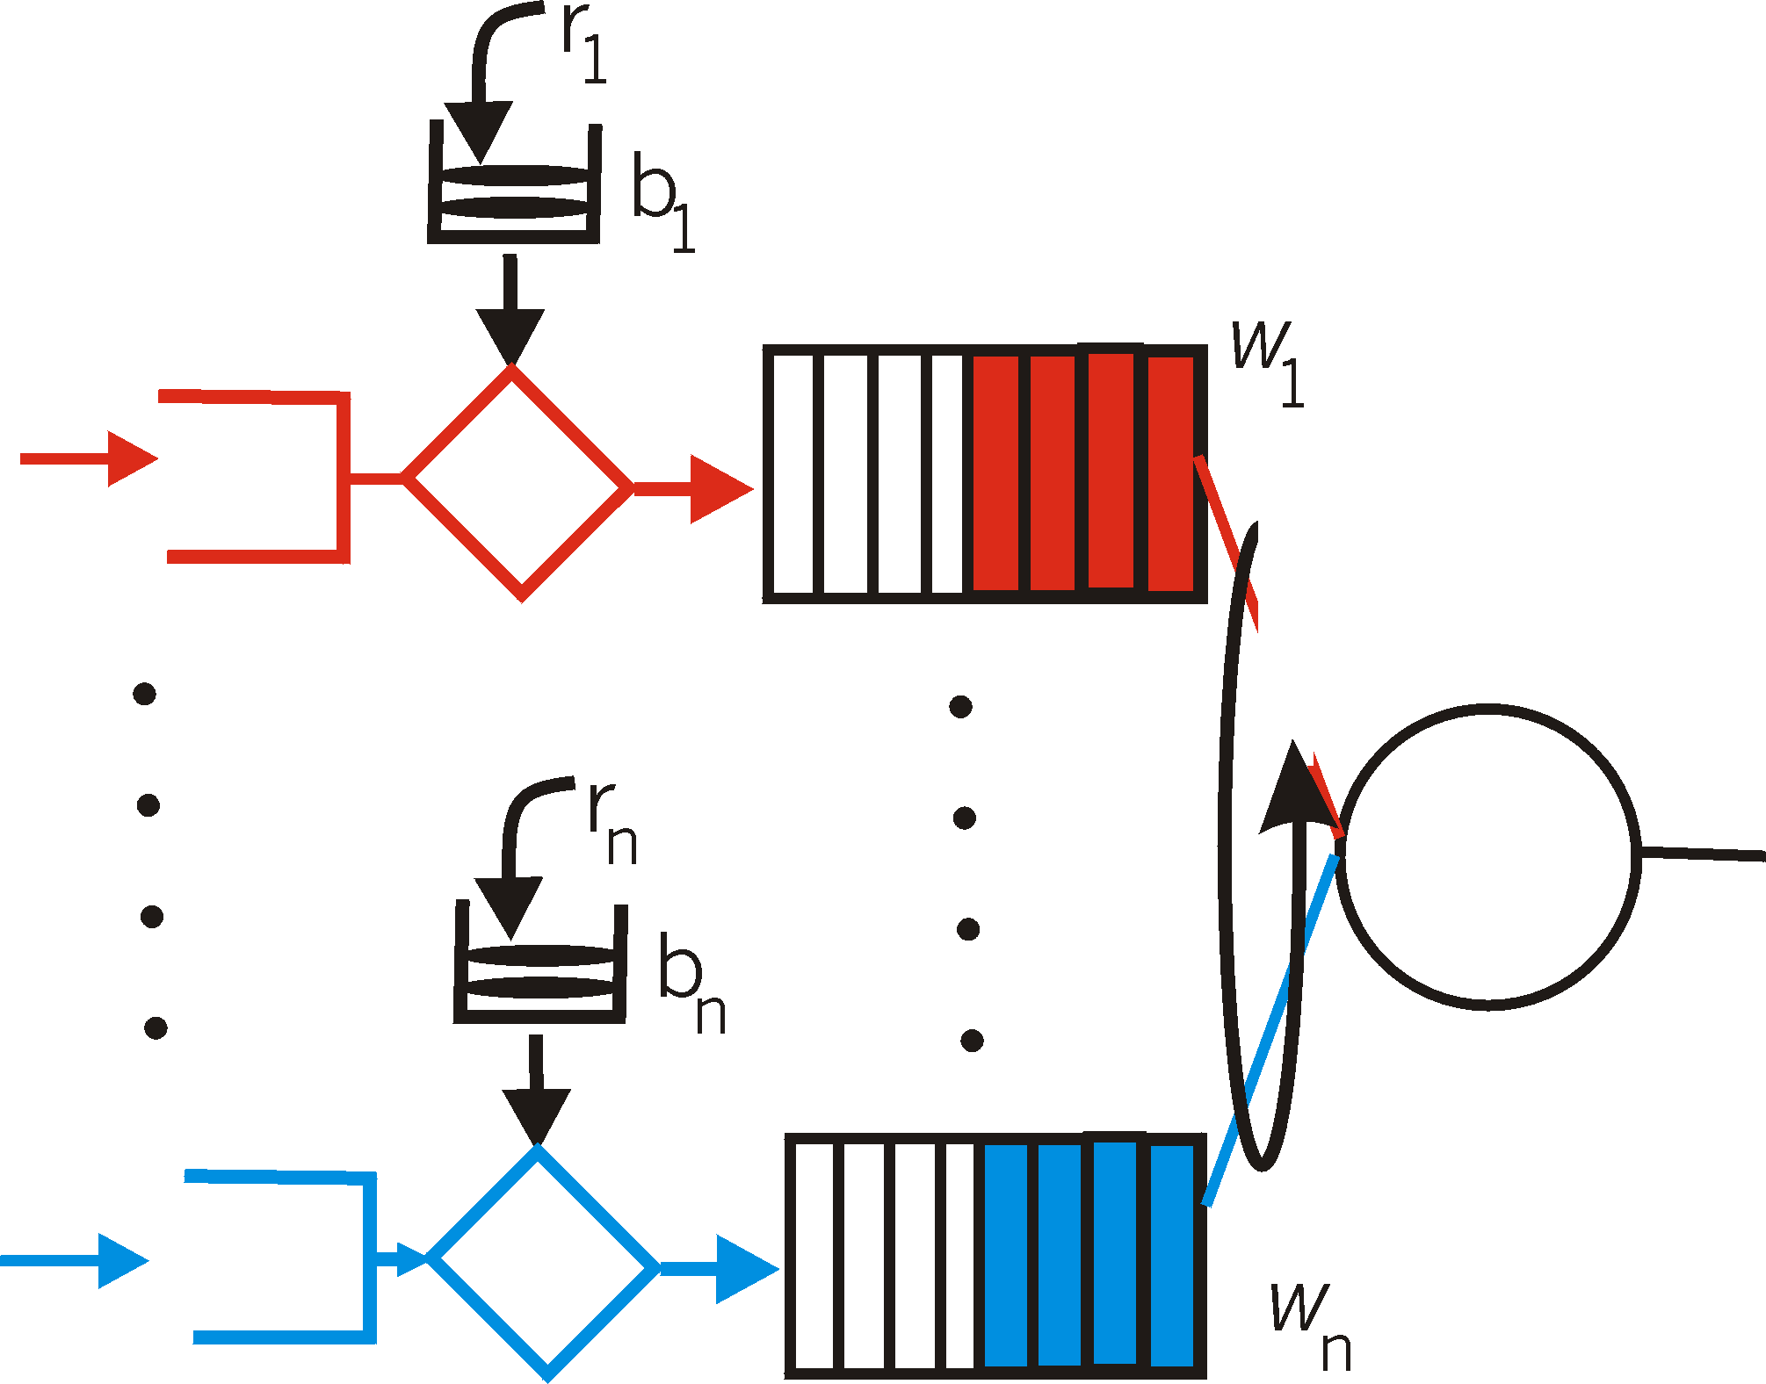
Policing Mechanisms
Leaky bucket + WFQ ➔ provide guaranteed upper bound on delay, i.e., QoS guarantee! How?
  WFQ: guaranteed share of bandwidth
  Leaky bucket: limit max number of packets in queue (burst)

Slide 24
QoS Models
Best effort - QoS is not enabled for this model. It is used for traffic that does not require any special treatment.
Integrated Services (IntServ) - Applications signal the network to make a bandwidth reservation and to indicate that they require special QoS treatment.
Differentiated Services (DiffServ) - The network identifies classes that require special QoS treatment.

Slide 25
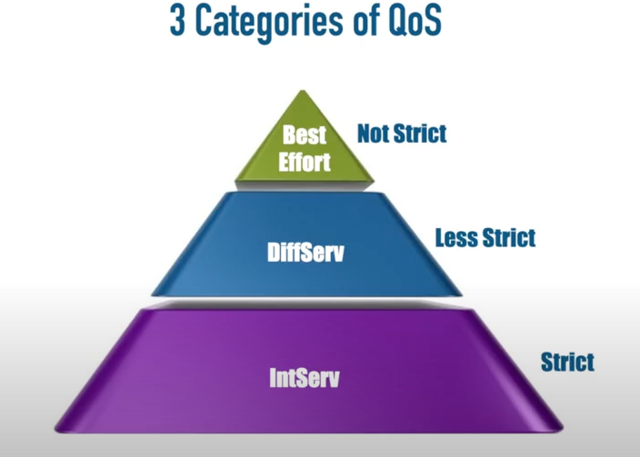
QoS Models
QoS is not enabled for this model. It is used for traffic that does not require any special treatment
The network identifies classes that require special QoS treatment.
Applications signal the network to make a bandwidth reservation and to indicate that they require special QoS treatment.

Slide 26
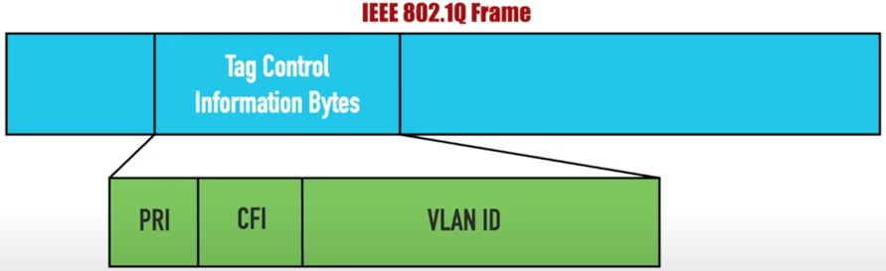
Class of Service (CoS)
CoS Bits

Slide 27
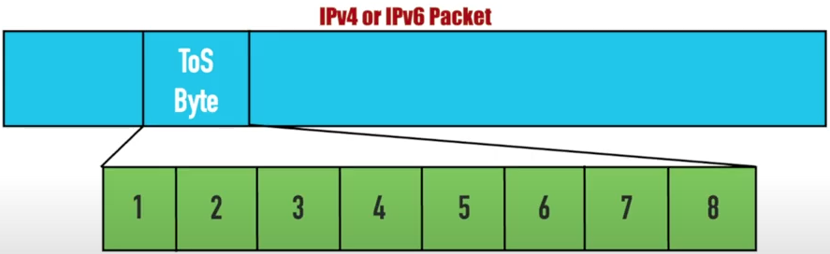
Type of Service (ToS) byte
Traffic Class in IPv6
0-5 for user applications
6-7 for network control traffic
IP precedence = priority
DSCP

Slide 28
QoS Support in IP Networks
Need for QoS
Principles
IntServ
DiffServ

Slide 29
IETF Integrated Services (IntServ)
architecture for providing QoS guarantees in IP networks for individual application sessions (flow)
resource reservation: routers maintain per flow state info of allocated resources, QoS req’s
admit/deny new call setup requests

Slide 30
Components of IntServ
Type of Service Model
  What does the network promise?
Service Interface
  How does the application describe what it wants?
Packet Scheduling
  How does the network meet promises?
Establishing the guarantee
  How is the promise communicated to/from the network?
  How is admission of new applications controlled?

Slide 31
Service Models Provided by IntServ
Service Types | Guaranteed | Control Load | Best Effort
Provide QoS | Guaranteed BW End-to-end Delay Bound | Emulate a lightly loaded network | None
RFC | RFC 2212 | RFC 2211 | None

Slide 32
IntServ – Guaranteed Service
Targets hard real-time applications
User specifies traffic characteristics and a service requirement.
The network should guarantee that the delay experienced < specified maximum value
Requires admission control at each of the routers.
Can mathematically guarantee bandwidth, delay and jitter.

Slide 33
IntServ – Controlled Load
Emulate a lightly loaded network even though the network as a whole may in fact be heavily loaded.
It does not guarantee strict delay bounds (like the Guaranteed Service model), but it tries to ensure that packets experience minimal delay and loss.
Targets applications that can adapt to network conditions within a certain performance window.
Use specifies traffic characteristics and bandwidth.
Requires admission control at each of the routers.

Slide 34
Controlled Load vs Guaranteed Service
Feature | Controlled Load | Guaranteed Service
Type of guarantee | Soft (best-effort under low load) | Hard (strict delay bound)
Delay sensitivity | Moderate | Very high
Applications | Video, VoIP, streaming | Industrial control, medical telemetry
Tolerance to loss | Somewhat tolerant | Very low tolerance

Slide 35



IntServ: QoS guarantee scenario
Resource reservation
  call setup, signaling (RSVP)
  traffic, QoS declaration
  per-element admission control
request/
reply
  QoS-sensitive scheduling (e.g., WFQ)

Slide 36
Call Admission
Arriving session must:
Declare its QoS requirement
  Reservation Specification (Rspec): defines the QoS being requested, e.g., bandwidth needed (rate r)
Characterize traffic it will send into network
  Traffic Specification (Tspec): defines traffic characteristics, e.g., average bit rate and maximum burst size (leaky bucket with rate r and buffer size b)
Signaling protocol: needed to carry R-spec and T-spec to routers (where reservation is required)
  RSVP
Notes:
Example: Use Leaky bucket. T-Spec: r (avg bitrate) and b (max burst size) and R-Spec: bandwidth needed

Slide 37
Packet Scheduling
Guarantee Service
  Use token bucket filter to characterize traffic
    Described by rate r and bucket depth b
Use WFQ at the routers
Notes:
Example: Use Leaky bucket. T-Spec: r (avg bitrate) and b (max burst size) and R-Spec: bandwidth needed

Slide 38
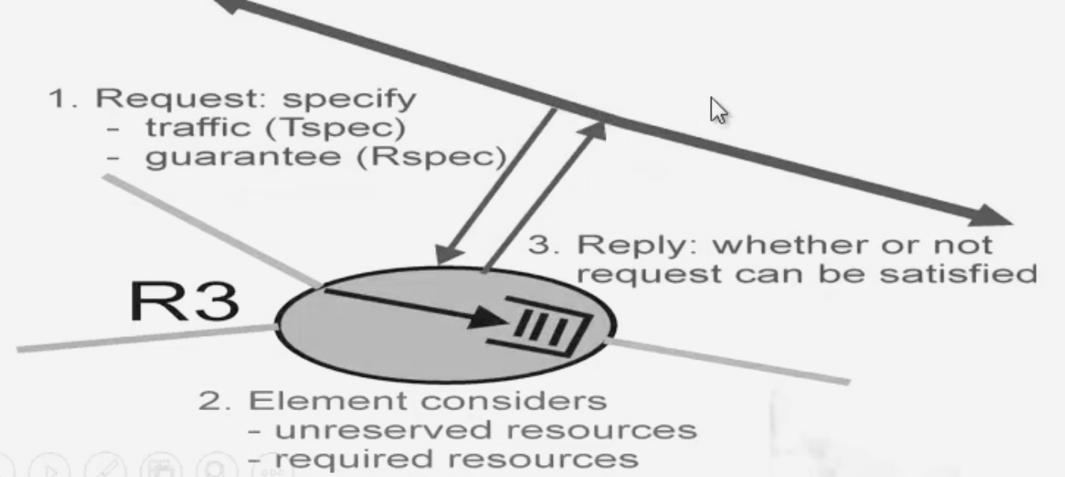
Call Admission
CA: routers admit call based on their R-Spec and T-Spec and the current resource allocated at the routers to other call.
Notes:
Example: Use Leaky bucket. T-Spec: r (avg bitrate) and b (max burst size) and R-Spec: bandwidth needed

Slide 39
Intserv Mechanisms
Flowspecs
  Set of information provided to the network
Resource Reservation (RSVP)
  Used to exchange information such as
    Requests for service,
    flowspecs,
    and admission control decisions.
Notes:
Example: Use Leaky bucket. T-Spec: r (avg bitrate) and b (max burst size) and R-Spec: bandwidth needed

Slide 40
Intserv - Flowspecs
Tspec: describes the flow’s traffic characteristics
The TSpec is often modeled using a token bucket:
b(t) ≤ b + r×t
where:
  b(t) = number of bits sent in time tt
  b = bucket size (burst)
  r = token rate (average rate)
RSVP-style TSpec
TSpec {
token_rate = 1 Mbps,
bucket_size = 5000 bytes,
peak_rate = 2 Mbps,
min_policed_unit = 64 bytes,
max_packet_size = 1500 bytes
}
Notes:
Parameter Description Symbol
Token Bucket Rate The average rate at which packets are expected to arrive (bits per second). r
Token Bucket Size The maximum burst size that can be sent at once (bytes or bits). B
Peak Data Rate The maximum rate at which packets can be sent. P
Minimum Policed Unit (m) The smallest packet size for which the flow is policed.
Smaller packets are treated as this size. m
Maximum Packet Size (M) The largest packet size in the flow. M

Slide 41
Intserv - Flowspecs
Rspec: describe the service required from the network
    Is service specific & easy to describe
    Contolled load service -> no parameters
    Guaranteed service -> delay target or bound
Parameter | Description | Symbol
Reserved Rate | The rate (bandwidth) the network must reserve for this flow. | R
Slack Term | Extra delay allowance (margin) beyond the minimum delay — used in Guaranteed Service. | S
Service Type | Indicates the type of IntServ service requested (e.g., Guaranteed or Controlled Load). | —
Notes:
Example: Use Leaky bucket. T-Spec: r (avg bitrate) and b (max burst size) and R-Spec: bandwidth needed

Slide 42
Intserv - Flowspecs
Guaranteed Service flow
RSpec {
service_type = Guaranteed,
reserved_rate = 1 Mbps,
slack_term = 10 ms
}
Controlled Load service
RSpec {
service_type = Controlled Load,
reserved_rate = 800 Kbps
}
Notes:
Example: Use Leaky bucket. T-Spec: r (avg bitrate) and b (max burst size) and R-Spec: bandwidth needed

Slide 43
Intserv – Flowspecs - RSVP
Requirements: Connection must be connectionless (end-to-end connectivity should be maintained)
Operates at the Transport Layer but interacts closely with the Network Layer.
  Full form: Resource ReSerVation Protocol
  RFC: Defined in RFC 2205
  Type: Signaling protocol (not a routing protocol)
  Purpose: To request and maintain QoS for IP data flows.
Notes:
Example: Use Leaky bucket. T-Spec: r (avg bitrate) and b (max burst size) and R-Spec: bandwidth needed

Slide 44
Intserv – Flowspecs - RSVP
In the IntServ model, RSVP is used to:
Carry TSpec (Traffic Specification) from sender to receiver.
Carry RSpec (Reservation Specification) from receiver to routers.
Communicate with routers along the path to reserve bandwidth and buffer space.
Maintain the reservation state as long as the application is active.
FlowSpec {
TSpec {
token_rate = 1 Mbps,
bucket_size = 5000 bytes,
peak_rate = 2 Mbps,
min_policed_unit = 64 bytes,
max_packet_size = 1500 bytes
}
RSpec {
service_type = Guaranteed,
reserved_rate = 1 Mbps,
slack_term = 10 ms
}
}

Slide 45
Intserv – Flowspecs – RSVP: how it works?
Step 1 — PATH Message (from Sender → Receiver)
  The sender sends an RSVP PATH message downstream.
  The PATH message carries the TSpec (traffic characteristics).
  Each router along the path stores path information for reverse communication.
Step 2 — RESV Message (from Receiver → Sender)
  The receiver, after receiving the PATH message, decides what QoS is needed.
  It sends a RESV (Reservation) message upstream.
  The RESV message carries the RSpec (resource requirements).
  Each router checks if it has enough resources to satisfy the request:
    If yes, it reserves them.
    If no, it rejects the request and sends an error message.

Slide 46
Intserv – Flowspecs – RSVP: how it works?
Step 3 — Data Flow
  Once the reservation is successful, data packets can flow through the path with guaranteed QoS.
Step 4 — Refresh and Tear Down
  RSVP is soft state — reservations expire if not refreshed.
  Periodic PATH and RESV messages refresh the reservation.
  PATH TEAR and RESV TEAR messages are used to remove reservations.
+-----------------------------------------------------------------+
| Common Header (Version, Message Type, Length) |
+-----------------------------------------------------------------+
| SESSION Object → identifies the data flow |
| RSVP_HOP Object → previous RSVP hop (IP address) |
| TIME_VALUES → refresh period, timeout |
| SENDER_TSPEC → traffic specification (TSpec) |
| FLOW_SPEC → reservation specification (RSpec) |
| STYLE → reservation style (fixed/filter) |
+-----------------------------------------------------------------+

Slide 47
OSI Layer | Role in IntServ | Involvement of TSpec / RSpec
Layer 7 – Application | Application requests QoS for a specific data flow (e.g., video streaming, VoIP). | Applications define TSpec and RSpecparameters and pass them to RSVP.
Layer 6 – Presentation | No direct involvement. | —
Layer 5 – Session | Manages the session and may request resource reservation for that session. | RSVP operates here conceptually to establish and maintain reservations.
Layer 4 – Transport | Works with RSVP to map QoS needs to transport flows (TCP/UDP ports). | RSVP messages carry TSpec/RSpec between endpoints.
Layer 3 – Network | Main layer for IntServ and RSVP. Routers use TSpec/RSpec to allocate bandwidth, schedule packets, and enforce QoS. | Core layer where TSpec/RSpec are interpreted and enforced.
Layer 2 – Data Link | Provides lower-level QoS mechanisms (e.g., priority queues, MAC scheduling). | May support the network layer’s QoS but doesn’t process TSpec/RSpec directly.
Layer 1 – Physical | Provides transmission capacity (bit rate, delay, etc.). | Only indirectly affects achievable QoS.

Slide 48
QoS Support in IP Networks
Need for QoS
Principles
IntServ
DiffServ

Slide 49
IETF Differentiated Services
Concerns with IntServ:
Scalability: signaling, maintaining per-flow router state difficult with large number of flows
Flexible Service Models: Intserv has only two classes. Also want “qualitative” service classes
  relative service distinction: Platinum, Gold, Silver
DiffServ approach:
simple functions in network core, relatively complex functions at edge routers (or hosts)
Don’t define service classes, provide functional components to build service classes

Slide 50

DiffServ Architecture
Edge router:
per-flow traffic ma nagement
Classifies (marks) pkts
  different classes
  within a class: in-profile and out-profile
marking
r
scheduling
.
b
.
.
Core router:
per class traffic management
buffering and scheduling based on marking at edge
preference given to in-profile packets

Slide 51
Edge-router Packet Marking
profile: pre-negotiated rate r, bucket size b
packet marking at edge based on per-flow profile
Rate r
b
User packets
Possible usage of marking:
class-based marking: packets of different classes marked differently
intra-class marking: conforming portion of flow marked differently than non-conforming one

Slide 52

Edge-router: Classification and Conditioning
Packet is marked in the Type of Service (TOS) in IPv4, and Traffic Class in IPv6
6 bits used for Differentiated Service Code Point (DSCP) and determine Per-Hop Behavior (PHB) that the packet will receive
2 bits are currently unused

Slide 53
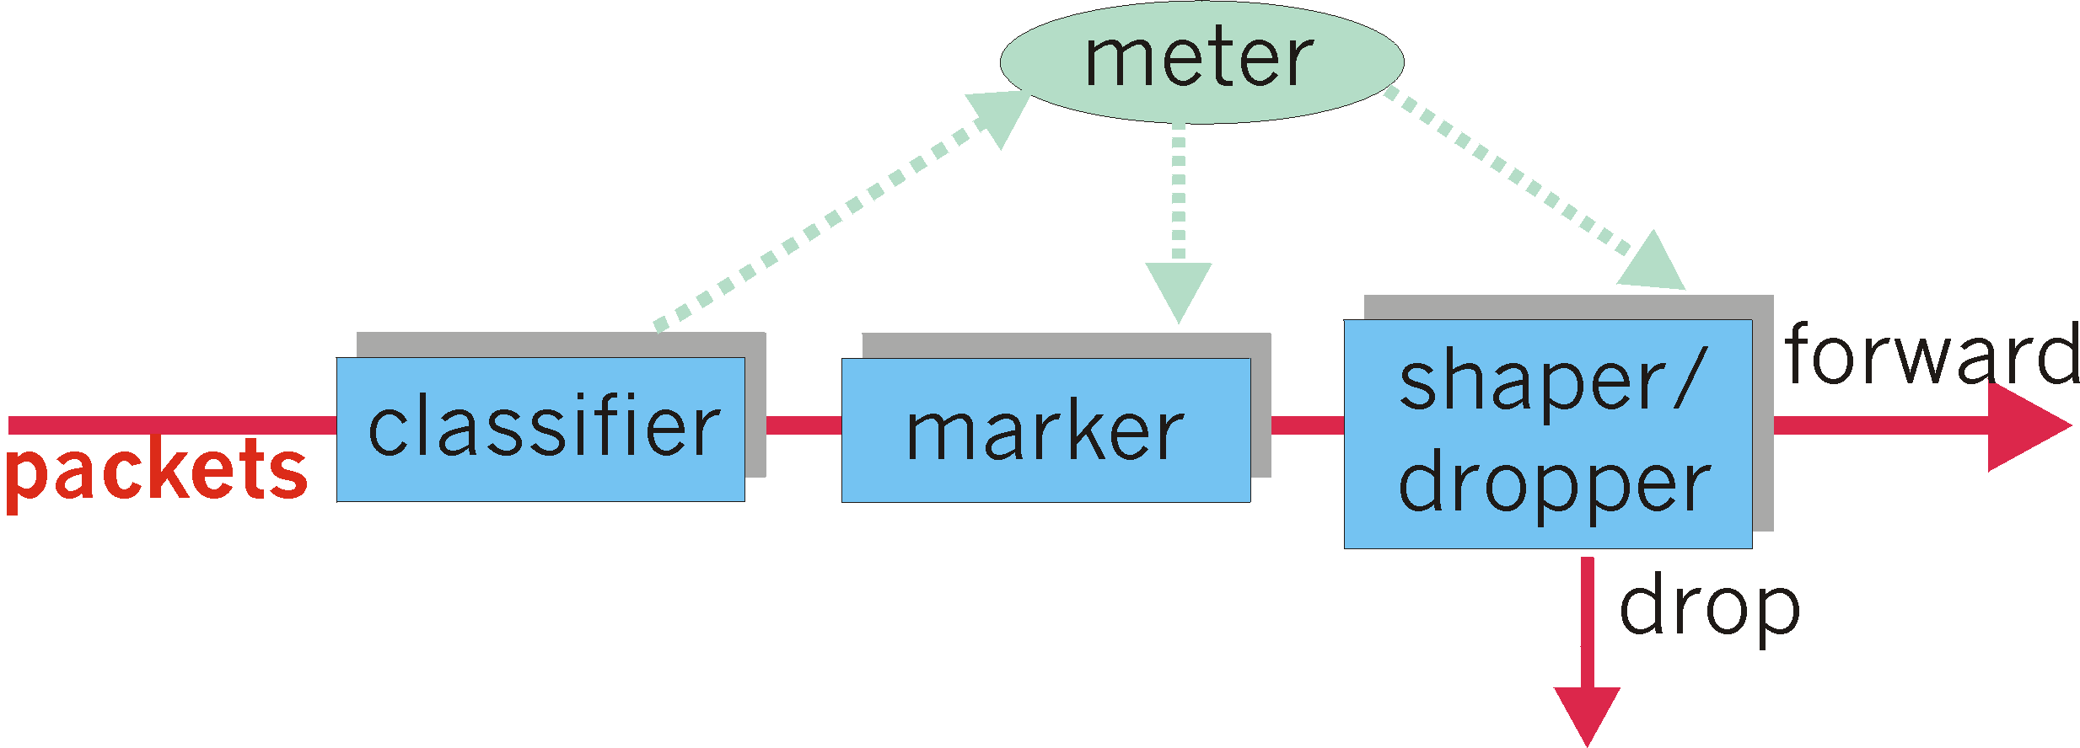
Edge-router: Classification and Conditioning
may be desirable to limit traffic injection rate of some class:
user declares traffic profile (e.g., rate, burst size)
traffic metered, shaped if non-conforming

Slide 54
Core-router: Forwarding (PHB)
PHB result in a different observable (measurable) forwarding performance behavior
PHB does not specify what mechanisms to use to ensure required PHB performance behavior
Examples:
  Class A gets x% of outgoing link bandwidth over time intervals of a specified length
  Class A packets leave first before packets from class B

Slide 55
Core-router: Forwarding (PHB)
PHBs being developed:
Expedited Forwarding (EF): pkt departure rate of a class equals or exceeds specified rate
  Logical link with a minimum guaranteed rate
  May require edge routers to limit EF traffic rate
  Could be implemented using strict priority scheduling or WFQ with higher weight for EF traffic
Assured Forwarding (AF): multiple traffic classes, treated differently
  Amount of bandwidth allocated, or drop priorities
  Can be implemented using WFQ + leaky bucket or RED (Random Early Detection) with different threshold values.
    See Sections 6.4.2 and 6.5.3 in [Peterson and Davie 07]

Slide 56
Core-router: Forwarding (PHB)
NAME (PHB) | Decimal Value | Binary Value
Default | 0 | 000000

Slide 57
Core-router: Forwarding (PHB)
NAME (PHB) | Decimal Value | Binary Value
Default | 0 | 000000
Expedited Forwarding (EF) | 46 | 101110

Slide 58
Core-router: Forwarding (PHB)
NAME (PHB) | Decimal Value | Binary Value
Default | 0 | 000000
Expedited Forwarding (EF) | 46 | 101110
Same as IP precedence bits
101 = 5
The highest precedence value in IPv4

Slide 59
Core-router: Forwarding (PHB)
NAME (PHB) | Decimal Value | Binary Value
Default | 0 | 000000
Expedited Forwarding (EF) | 46 | 101110
Class Selector 1 (CS1) | 8 | 001000

Slide 60
Core-router: Forwarding (PHB)
NAME (PHB) | Decimal Value | Binary Value
Default | 0 | 000000
Expedited Forwarding (EF) | 46 | 101110
Class Selector 1 (CS1) | 8 | 001000
Class Selector 2 (CS2) | 16 | 010000

Slide 61
Core-router: Forwarding (PHB)
NAME (PHB) | Decimal Value | Binary Value
Default | 0 | 000000
Expedited Forwarding (EF) | 46 | 101110
Class Selector 1 (CS1) | 8 | 001000
Class Selector 2 (CS2) | 16 | 010000
Class Selector 3 (CS3) | 24 | 011000
Class Selector 4 (CS4) | 32 | 100000
Class Selector 5 (CS5) | 40 | 101000
Class Selector 6 (CS6) | 48 | 110000
Class Selector 7 (CS7) | 56 | 111000

Slide 62
DSCP Assured Forwarding
 | Low Drop Probability | Medium Drop Probability | High Drop Probability
Class 1 | AF11 (10) 001010 | AF12 (12) 001100 | AF13 (14) 001110
Class 2 | AF21 (18) 010010 | AF22 (20) 010100 | AF23 (22) 010110
Class 3 | AF31 (26) 011010 | AF32 (28) 011100 | AF33 (30) 011110
Class 4 | AF41 (34) 100010 | AF42 (36) 100100 | AF43 (38) 100110

Slide 63
DSCP Assured Forwarding
 | Low Drop Probability | Medium Drop Probability | High Drop Probability
Class 1 | AF11 (10) 001010 | AF12 (12) 001100 | AF13 (14) 001110
Class 2 | AF21 (18) 010010 | AF22 (20) 010100 | AF23 (22) 010110
Class 3 | AF31 (26) 011010 | AF32 (28) 011100 | AF33 (30) 011110
Class 4 | AF41 (34) 100010 | AF42 (36) 100100 | AF43 (38) 100110

Slide 64
DSCP Assured Forwarding
 | Low Drop Probability | Medium Drop Probability | High Drop Probability
Class 1 | AF11 (10) 001010 | AF12 (12) 001100 | AF13 (14) 001110
Class 2 | AF21 (18) 010010 | AF22 (20) 010100 | AF23 (22) 010110
Class 3 | AF31 (26) 011010 | AF32 (28) 011100 | AF33 (30) 011110
Class 4 | AF41 (34) 100010 | AF42 (36) 100100 | AF43 (38) 100110

Slide 65
DSCP Assured Forwarding
 | Low Drop Probability | Medium Drop Probability | High Drop Probability
Class 1 | AF11 (10) 001010 | AF12 (12) 001100 | AF13 (14) 001110
Class 2 | AF21 (18) 010010 | AF22 (20) 010100 | AF23 (22) 010110
Class 3 | AF31 (26) 011010 | AF32 (28) 011100 | AF33 (30) 011110
Class 4 | AF41 (34) 100010 | AF42 (36) 100100 | AF43 (38) 100110

Slide 66
DSCP Assured Forwarding
 | Low Drop Probability | Medium Drop Probability | High Drop Probability
Class 1 | AF11 (10) 001010 | AF12 (12) 001100 | AF13 (14) 001110
Class 2 | AF21 (18) 010010 | AF22 (20) 010100 | AF23 (22) 010110
Class 3 | AF31 (26) 011010 | AF32 (28) 011100 | AF33 (30) 011110
Class 4 | AF41 (34) 100010 | AF42 (36) 100100 | AF43 (38) 100110

Slide 67
DSCP Assured Forwarding
 | Low Drop Probability | Medium Drop Probability | High Drop Probability
Class 1 | AF11 (10) 001010 | AF12 (12) 001100 | AF13 (14) 001110
Class 2 | AF21 (18) 010010 | AF22 (20) 010100 | AF23 (22) 010110
Class 3 | AF31 (26) 011010 | AF32 (28) 011100 | AF33 (30) 011110
Class 4 | AF41 (34) 100010 | AF42 (36) 100100 | AF43 (38) 100110

Slide 68
DSCP Assured Forwarding
 | Low Drop Probability | Medium Drop Probability | High Drop Probability
Class 1 | AF11 (10) 001010 | AF12 (12) 00100 | AF13 (14) 001110
Class 2 | AF21 (18) 010010 | AF22 (20) 010100 | AF23 (22) 010110
Class 3 | AF31 (26) 011010 | AF32 (28) 011100 | AF33 (30) 011110
Class 4 | AF41 (34) 100010 | AF42 (36) 100100 | AF43 (38) 100110

Slide 69
Question
A DSCP PHB name of CS4 has what equivalent decimal value?

Slide 70
Answer
Type of Service (ToS) Byte
1 | 2 | 3 | 4 | 5 | 6 | 7 | 8
CS4

Slide 71
Answer
Type of Service (ToS) Byte
1 | 2 | 3 | 4 | 5 | 6 | 7 | 8
IP Precedence
4 | 2 | 1
1 | 0 | 0
CS4

Slide 72
Answer
Type of Service (ToS) Byte
1 | 2 | 3 | 4 | 5 | 6 | 7 | 8
IP Precedence
4 | 2 | 1
1 | 0 | 0
CS4
DSCP
32 | 16 | 8 | 4 | 2 | 1
1 | 0 | 0 | 0 | 0 | 0
= 32

Slide 73
Question
A DSCP decimal value of 20 has what equivalent PHB name?

Slide 74
Answer
Type of Service (ToS) Byte
1 | 2 | 3 | 4 | 5 | 6 | 7 | 8

Slide 75
Answer
Type of Service (ToS) Byte
1 | 2 | 3 | 4 | 5 | 6 | 7 | 8
DSCP (Decimal Value = 20)
32 | 16 | 8 | 4 | 2 | 1
0 | 1 | 0 | 1 | 0 | 0

Slide 76
Answer
Type of Service (ToS) Byte
1 | 2 | 3 | 4 | 5 | 6 | 7 | 8
DSCP (Decimal Value = 20)
32 | 16 | 8 | 4 | 2 | 1
0 | 1 | 0 | 1 | 0 | 0
4 | 2 | 1 | 2 | 1 | Always zero
 |  |  |  |  | 0

Slide 77
Answer
Type of Service (ToS) Byte
1 | 2 | 3 | 4 | 5 | 6 | 7 | 8
DSCP (Decimal Value = 20)
32 | 16 | 8 | 4 | 2 | 1
0 | 1 | 0 | 1 | 0 | 0
4 | 2 | 1 | 2 | 1 | Always zero
0 | 1 | 0 |  |  | 0

Slide 78
Answer
Type of Service (ToS) Byte
1 | 2 | 3 | 4 | 5 | 6 | 7 | 8
DSCP (Decimal Value = 20)
32 | 16 | 8 | 4 | 2 | 1
0 | 1 | 0 | 1 | 0 | 0
4 | 2 | 1 | 2 | 1 | Always zero
0 | 1 | 0 | 1 | 0 | 0
A Decimal Value of 20 has a DSCP Value of AF22

